Slide 1
WEB Scraping with Python: Extracting book data

Slide 2
A Practical Guide to Extracting and Analyzing Book Information from Websites
Presented By:-
Name | Roll Number
Tejal Khade | P23CS019
Shivani Pal | P23CS006
Aditi Das | P23DS008

Slide 3
Contents
Introduction to Web Scraping
Web Scraping Code Overview
Link of Web Page and Structure
Data Extraction and Storage
Exploratory Data Analysis (EDA)
Matrix Operations with NumPy
Advanced Data Visualization
Conclusion

Slide 4
1. Introduction to web Scraping

Slide 5
What is Web Scraping?
Web scraping is a technique for extracting data from websites.
It involves fetching web page content and then parsing and extracting the desired information.

Slide 6
Key Components
URL Request: Sending a request to a URL using libraries like ‘requests’.
HTML Parsing: Parsing HTML content using tools like ‘BeautifulSoup’.
Data Extraction: Extracting relevant data from HTML elements.

Slide 7
Applications
Data Collection:
Gathering data for analysis, research, or business intelligence.
Price Monitoring:
Tracking product prices on e-commerce sites.
Research:
Collecting information for academic or market research.

Slide 8
Python Libraries
Requests:
For making HTTP requests to the website.
BeautifulSoup:
For parsing HTML content and navigating the HTML tree.

Slide 9
Legality and Ethics
Review Website's Terms of Service:
Ensure compliance with the website's terms.
Ethical Considerations:
Use web scraping responsibly and avoid causing harm.

Slide 10
Why Python?
Ease of Use:
Python offers simplicity and readability.
Rich Libraries:
Abundance of libraries for web scraping and data manipulation.

Slide 11
2. web scraping code overview

Slide 12
Python code snippet for web scraping
# Web Scraping Code Overview
# Importing Libraries
from urllib.request import urlopen
import requests
from bs4 import BeautifulSoup
import pandas as pd
# URL to scrape
url = 'https://www.bookswagon.com/promo-best-seller/award-winning/2109CDC4B4DC'
# Send a GET request to the URL
webpage = requests.get(url)
# Parse the HTML content of the page
soup = BeautifulSoup(webpage.content, 'html.parser')
# Find elements with class 'row bestsellerbox'
containers = soup.find_all('div', {'class': 'row bestsellerbox'})
# Extract data from each container
for container in containers:
# Extract Book Title, Authors, Current Price, MRP, Discount, Web Link
# (Code for extraction is not displayed here for brevity)
# Store extracted data in a CSV file
df.to_csv('book_data.csv', index=False)
print("Data extraction and storage completed!")

Slide 13
3.Link of web page and Structure

Slide 14
URL
https://www.bookswagon.com/promo-best-seller/award-winning/2109CDC4B4DC
The web page is a promotional page for award-winning books on Bookswagon.

Slide 15
HTML Structure:
<!DOCTYPE html>
<html lang="en">
<head>
<!-- Head section with metadata and stylesheets -->
</head>
<body>
<header>
<!-- Header content: logo, navigation, search bar -->
</header>
<main>
<!-- Main content area with book categories -->
<div class="row bestsellerbox">
<!-- Book container with title, author, price, discount -->
</div>
<!-- Additional book containers -->
</main>
<footer>
<!-- Footer content: links, contact info, social media -->
</footer>
</body>
</html>

Slide 16
Key Elements
Book Container: Each book is encapsulated in a ‘<div>’ with the class 'row bestsellerbox’.
Book Information: Title, authors, prices, and discount details are contained within specific ‘<span>’ and ‘<div>’ elements.

Slide 17
Targeted Data
The goal is to extract information from the 'bestsellerbox' containers.
Specific classes and tags are used to locate and extract book-related details.

Slide 18
4.Data extraction and storage

Slide 19
import requests
from bs4 import BeautifulSoup
import csv
import pandas as pd # Import pandas for numeric conversion
def scrape_and_store_data(url, container_class, csv_filename):
try:
# Send a GET request to the URL
response = requests.get(url)
response.raise_for_status() # Raise an HTTPError for bad requests
# Parse the HTML content of the page
soup = BeautifulSoup(response.text, 'html.parser')

Slide 20
# Find the element with the specified container class
container = soup.find('div', class_=container_class) # Replace 'div' with the actual tag type
if container:
# Open a CSV file for writing
with open(csv_filename, 'w', newline='', encoding='utf-8') as csvfile:
csv_writer = csv.writer(csvfile)
# Write header row
csv_writer.writerow(['Book_Title', 'Authors', 'Current_Price', 'MRP', 'Discount', 'WebLinks'])

Slide 21
# Find all book containers within the main container
book_containers = container.find_all('div', class_='col-sm-20') # Replace with the actual class name
for book_container in book_containers:
# Extract Book Title
book_title_span = book_container.find('span', class_='booktitle font-weight-bold')
book_title = book_title_span.text.split('-')[0].strip() if book_title_span else 'No Title'

Slide 22
# Extract Author
author_span = book_container.find('span', class_='author authortextcolor')
author = author_span.text.strip() if author_span else 'No author found'
# Extract Current Price and convert to numeric
current_price_span = book_container.find('span', class_='actualprice')
current_price = pd.to_numeric(current_price_span.text.replace(',', '').replace('₹', '').strip(), errors='coerce') if current_price_span else 0

Slide 23
# Extract MRP and convert to numeric
mrp_span = book_container.find('span', class_='initialprice')
mrp = pd.to_numeric(mrp_span.text.replace(',', '').replace('₹', '').strip(), errors='coerce') if mrp_span else 0
# Extract Discount and convert to numeric
discount_div = book_container.find('div', class_='offer position-absolute')
discount = pd.to_numeric(discount_div.text.replace(',', '').replace('%', '').strip(), errors='coerce') if discount_div else 0

Slide 24
# Extract Web Link
web_link = book_container.find('a', href=True)['href'] if book_container.find('a', href=True) else 'No Link'
# Write data to CSV
csv_writer.writerow([book_title, author, current_price, mrp, discount, web_link])
print(f"Data extracted!")
else:
print(f"No element with class '{container_class}' found.")

Slide 25
except requests.exceptions.RequestException as e:
print(f"Error: {e}")
# Example usage:
url_to_scrape = "https://www.bookswagon.com/promo-best-seller/award-winning/2109CDC4B4DC"
container_class_to_find = "row bestsellerbox" # Replace with the actual class name
csv_file = "books_data.csv"
scrape_and_store_data(url_to_scrape, container_class_to_find, csv_file)

Slide 26
5 Exploratory Data Analysis (EDA)

Slide 27
import pandas as pd # Load the data from the CSV file
df = pd.read_csv('bookswagon_data.csv')
# Display basic information about the dataset
print(df.info())
# Display the first few rows of the dataframe
print(df.head())
# Display summary statistics
print(df.describe())
# Check for missing values
print(df.isnull().sum())
# Handle missing values if any
print("Number of duplicate rows:", df.duplicated().sum())
df = df.drop_duplicates()

Slide 28
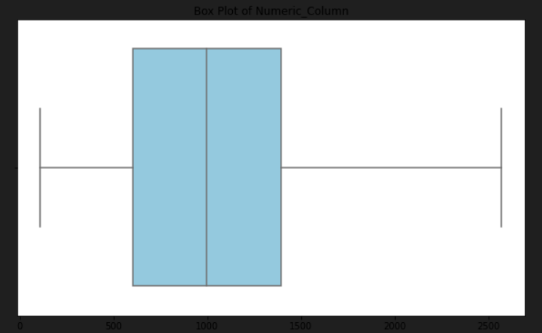
#Univariate Analysis
import seaborn as sns
import matplotlib.pyplot as plt
plt.figure(figsize=(10, 6))
sns.boxplot(x=df['Current_Price'], color='skyblue')
plt.title('Box Plot of Numeric_Column')
plt.xlabel('Current_Price')
plt.show()

Slide 29

import matplotlib.pyplot as plt
# Visualize distribution of numerical features
plt.hist(df['Current_Price'], bins=20)
plt.title('Distribution of Current Prices')
plt.show()

Slide 30
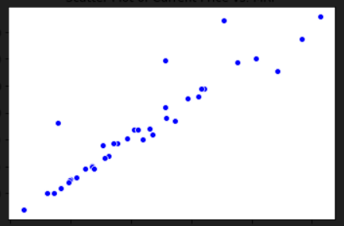
# BIVARIATE ANALYSIS
# Visualize relationships between variables
import seaborn as sns
import matplotlib.pyplot as plt
# Assuming 'df' is your DataFrame with the 'Current_Price' and 'MRP' columns # Replace 'df' with your actual DataFrame
sns.scatterplot(x='Current_Price', y='MRP', data=df, color='blue')
plt.title('Scatter Plot of Current Price vs. MRP')
plt.xlabel('Current Price')
plt.ylabel('MRP')
plt.show()

Slide 31
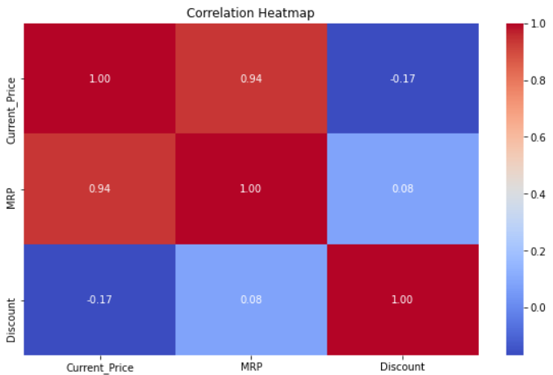
MULTIVARIATE ANALYSIS
import seaborn as sns
import matplotlib.pyplot as plt
# Assuming 'df' is your DataFrame with multiple numerical columns
# Replace 'df' with your actual DataFrame
correlation_matrix = df.corr()
plt.figure(figsize=(10, 6))
sns.heatmap(correlation_matrix, annot=True, cmap='coolwarm', fmt='.2f')
plt.title('Correlation Heatmap')
plt.show()

Slide 32
6 Matrix Operations with NumPy

Slide 33
import pandas as pd
import numpy as np
# Convert relevant columns to NumPy arrays
current_price_array = df['Current_Price'].to_numpy()
mrp_array = df['MRP'].to_numpy()
# Perform Matrix Operations
# 1. Addition
sum_result = current_price_array + mrp_array
# 2. Subtraction
difference_result = current_price_array - mrp_array
# 3. Element-wise Multiplication
product_result = current_price_array * mrp_array

Slide 34
# 4. Element-wise Division
division_result = current_price_array / mrp_array
# 5. Matrix Dot Product
dot_product_result = np.dot(current_price_array, mrp_array)
# Display the results
print("Addition Result:", sum_result)
print("\n")
print("Subtraction Result:", difference_result)
print("\n")
print("Element-wise Multiplication Result:", product_result)
print("\n")
print("Element-wise Division Result:", division_result)
print("\n")
print("Matrix Dot Product Result:", dot_product_result)

Slide 35
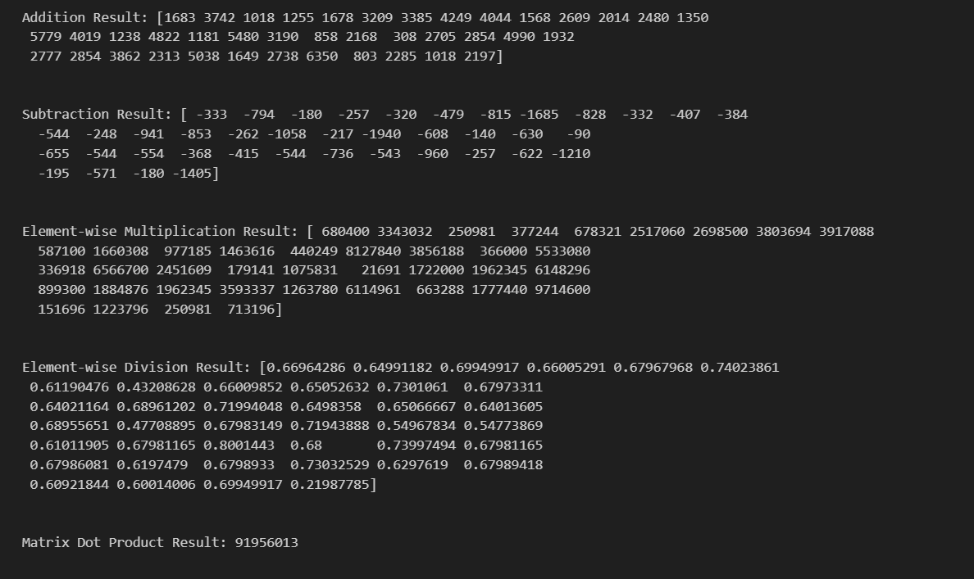

Slide 36
7 DataVisualization

Slide 37
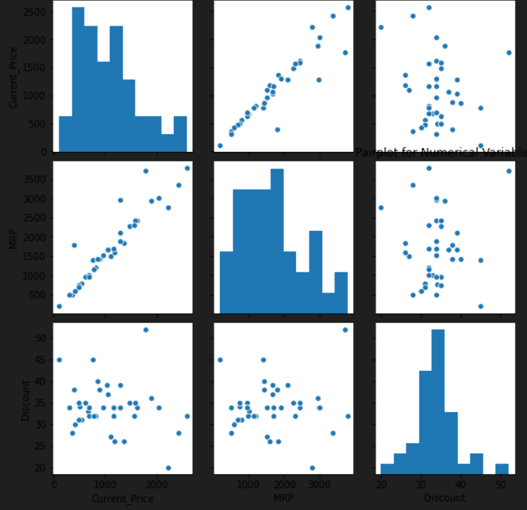
import seaborn as sns
import matplotlib.pyplot as plt
import pandas as pd
# 1. Pairplot for relationship between numerical variables
sns.pairplot(df[['Current_Price', 'MRP', 'Discount']])
plt.title('Pairplot for Numerical Variables')
plt.show()

Slide 38
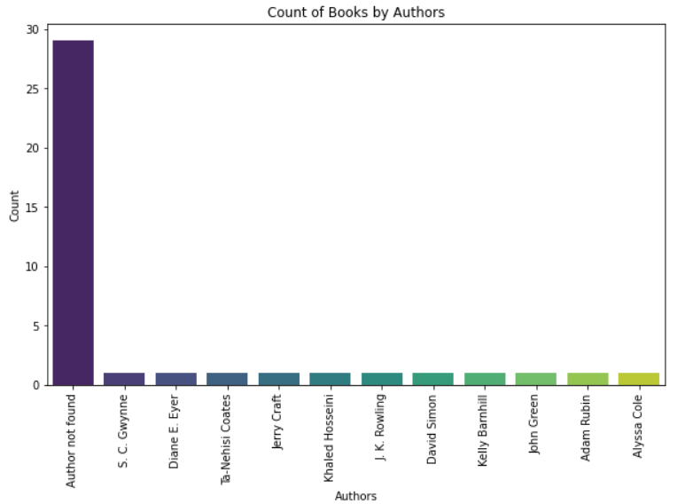
import seaborn as sns
import matplotlib.pyplot as plt
# Assuming 'df' is your DataFrame with the 'Authors' column
# Replace 'df' and 'Authors' with your actual DataFrame and column name
plt.figure(figsize=(10, 6))
sns.countplot(x='Authors', data=df, order=df['Authors'].value_counts().index, palette='viridis')
plt.title('Count of Books by Authors')
plt.xlabel('Authors')
plt.ylabel('Count')
plt.xticks(rotation=90)
plt.show()

Slide 39
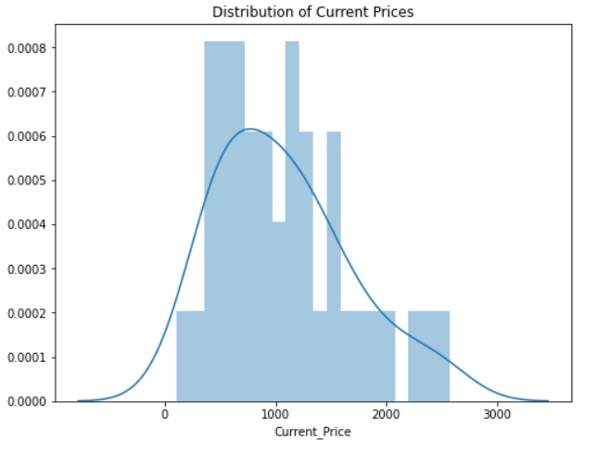
# 2. Distribution of 'Current_Price'
plt.figure(figsize=(8, 6))
sns.distplot(df['Current_Price'], bins=20, kde=True)
plt.title('Distribution of Current Prices')
plt.show()

Slide 40
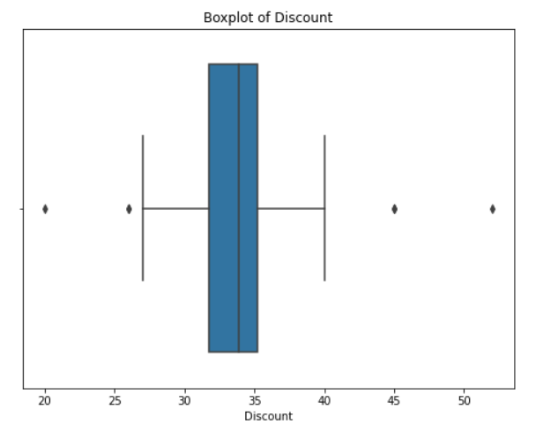
# 3. Boxplot for 'Discount'
plt.figure(figsize=(8, 6))
sns.boxplot(x='Discount', data=df)
plt.title('Boxplot of Discount')
plt.show()

Slide 41
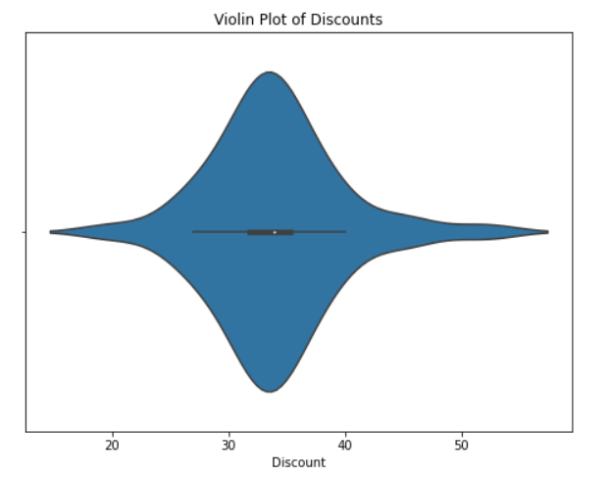
plt.figure(figsize=(8, 6))
sns.violinplot(x='Discount', data=df)
plt.title('Violin Plot of Discounts')
plt.xlabel('Discount')
plt.show()

Slide 42
8. CONCLUSION

Slide 43
In this project, we successfully implemented a web scraping script to extract valuable information about books from the BooksWagon website. The script utilized Python libraries such as requests, BeautifulSoup, and pandas to efficiently navigate and extract data from the HTML structure of the webpage.
Dynamic Web Scraping: The script dynamically retrieves book data from the provided URL, making it adaptable to changes in the website's structure.
Data Cleansing: To ensure data accuracy, we implemented data cleansing techniques using the pandas library. This included converting price and discount values to numeric format for better analysis.
CSV Export: Extracted data is stored in a CSV file, providing a structured format that is easy to analyze
EDA: performed analysis of variable and done preprocessing also.

Slide 44


